Slide 1
Welcome to the third virtual meeting of the Culture/Cultural Heritage Partnership!
The meeting will start at 10.00. Please feel free to test your microphone and camera in the meanwhile.
Please note that this meeting will be recorded, and the chat and the voting results saved
If you have any technical difficulties, you can contact us via phone:
+32 2 743 89 31
or email:
UA.communication@Ecorys.com

Slide 2
Please go to www.menti.com and use the code 82 40 20

Slide 3
Culture/Cultural Heritage Partnership
3rd Partnership meeting
Webex meeting, 18 June 2020

Slide 4
Please remember to mute your microphone and turn off your camera when the meeting starts and when you are not speaking.
If you have any technical difficulties, you can contact us via phone:
+32 2 743 89 31
or email:
UA.communication@Ecorys.com

Slide 5
Opening

Slide 6
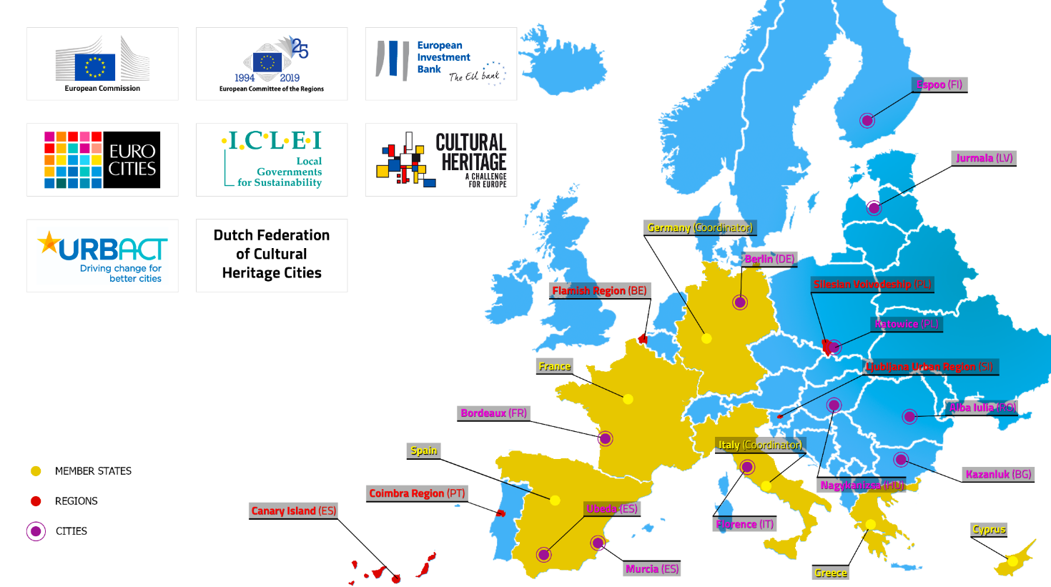
Welcome new members!
Greece & Murcia (ES)

Slide 7
Agenda 18 June, 10:00-12:30
Welcome and opening (Giorgio & Gaby)
State of play of the Partnership (Jan, Sandra & Giovanni)
Objectives of the meeting (Jan, Sandra & Giovanni)
Presentation of short-listed Actions (Jan, Sandra & Giovanni)
Ranking of Actions (all members participants)
Discussion (all Actions Leaders)
Conclusions and next steps (Coordinators)

Slide 8
State of play of the Partnership and objectives of the meeting
Sandra Gizdulich, Giovanni Pineschi | Agenzia per la Coesione Territoriale
Jan Schultheiß | Federal Ministry of the Interior,
Building and Community

Slide 9
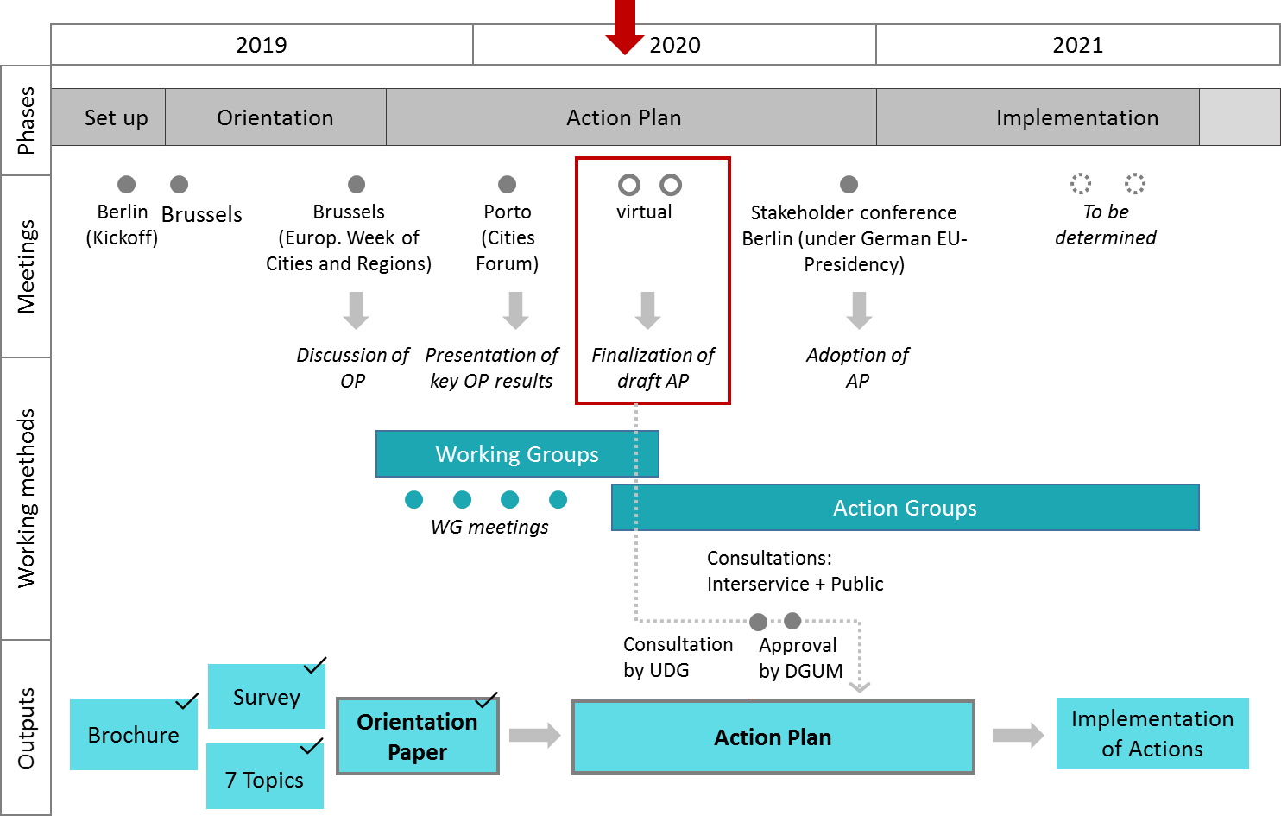
Timeline

Slide 10
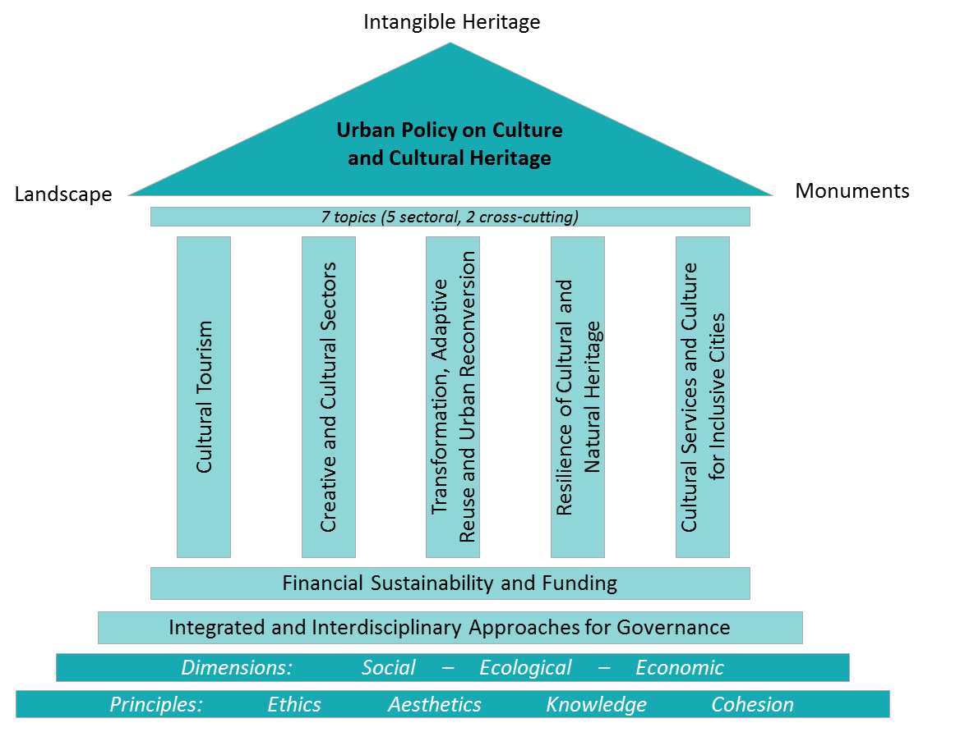
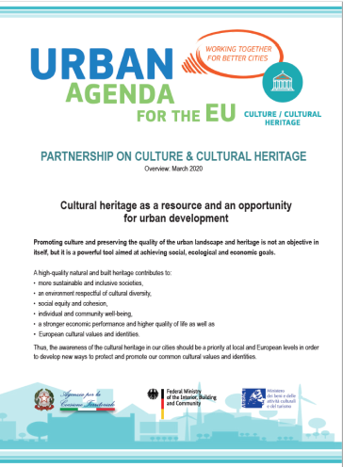
The Working Group (WG) & Pillars
The 5 THEMATIC WGs
NEW BROUCHURE AVALIABLE, look in SharePoint, Futurium… or your e-mail!

Slide 11
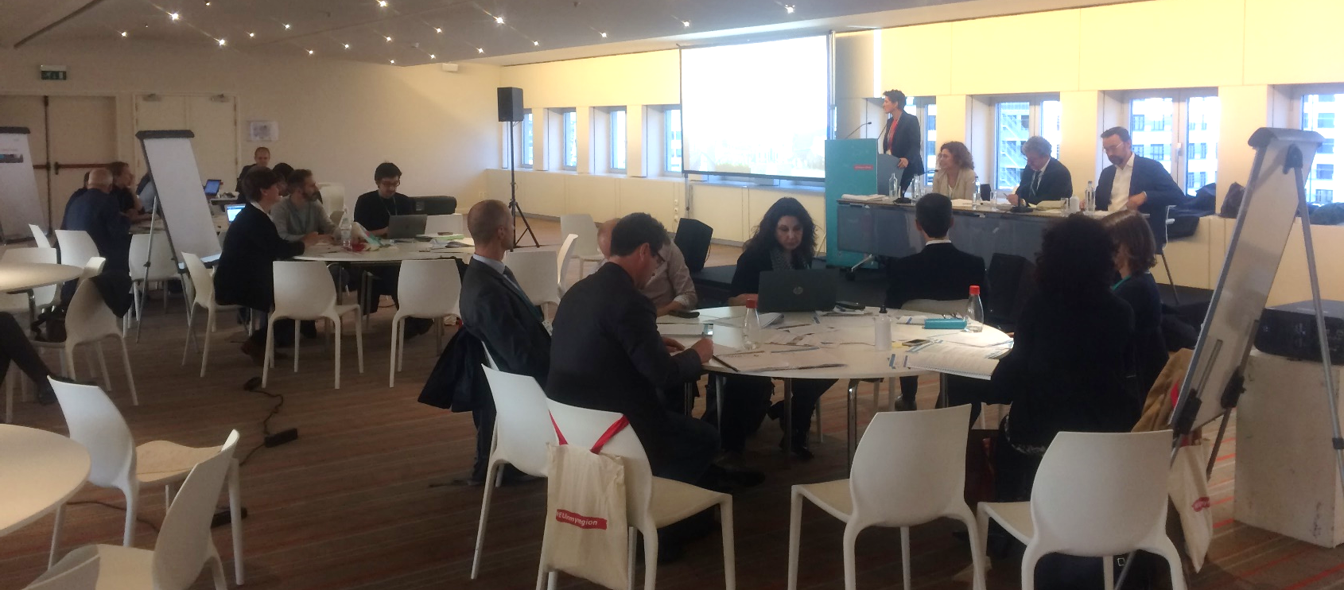
EWRC Brussels 9 October 2019
Discussion of OP in 7 Working Groups

Slide 12
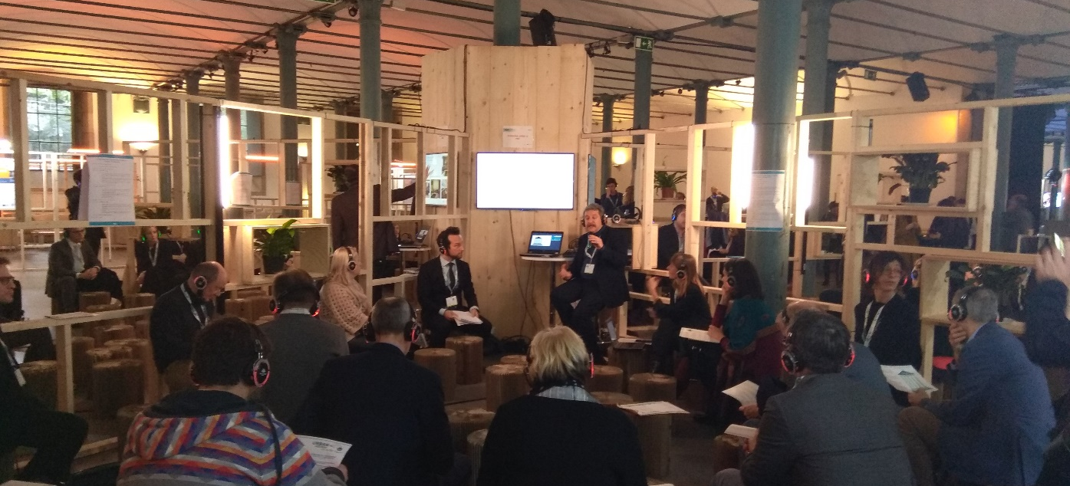
Cities Forum Porto 30/31 January 2020
Presentation of OP Themes in „silent disco“, exchange with other Partnerships

Slide 13
State of Play – Experts and WGs
Selected 5 External Experts for the 5WGs: dissemination and feedback from members to their inputs;
Coordinators and WG Leaders defined WGs’ path (methods and planning) and work to be done (coordinators meetings);
WG Leaders hold periodical WG meetings to define thematic actions;
Coordinators met with WG Leaders (plenary and bilaterally) to solve problems, pre-evaluate and merged actions;
Coordinators meet with Partnership Public Security and with the European Commission and other UA Partnership Coordinators.

Slide 14
External experts:
WG 1 (Cultural Tourism): KEA (Arthur Le Gall)
WG 2 (Cultural Sectors): Ecorys (Toms Feifs)
WG 3 (Transformation): Eutropian (Daniela Patti)
WG 4 (Resilience): World Bank (Barbara Minguez Garcia)
WG 5 (Cultural Services): KEA (Philippe Kern)

Slide 15

EWRC Brussels October 2020
IT IS NOT CONSIDERED AS A PARTNERSHIP MEETING (AS THE ONE OF 2019) BUT … SAVE THE DATE!
Q&A + feedback on Action Plan

Slide 16
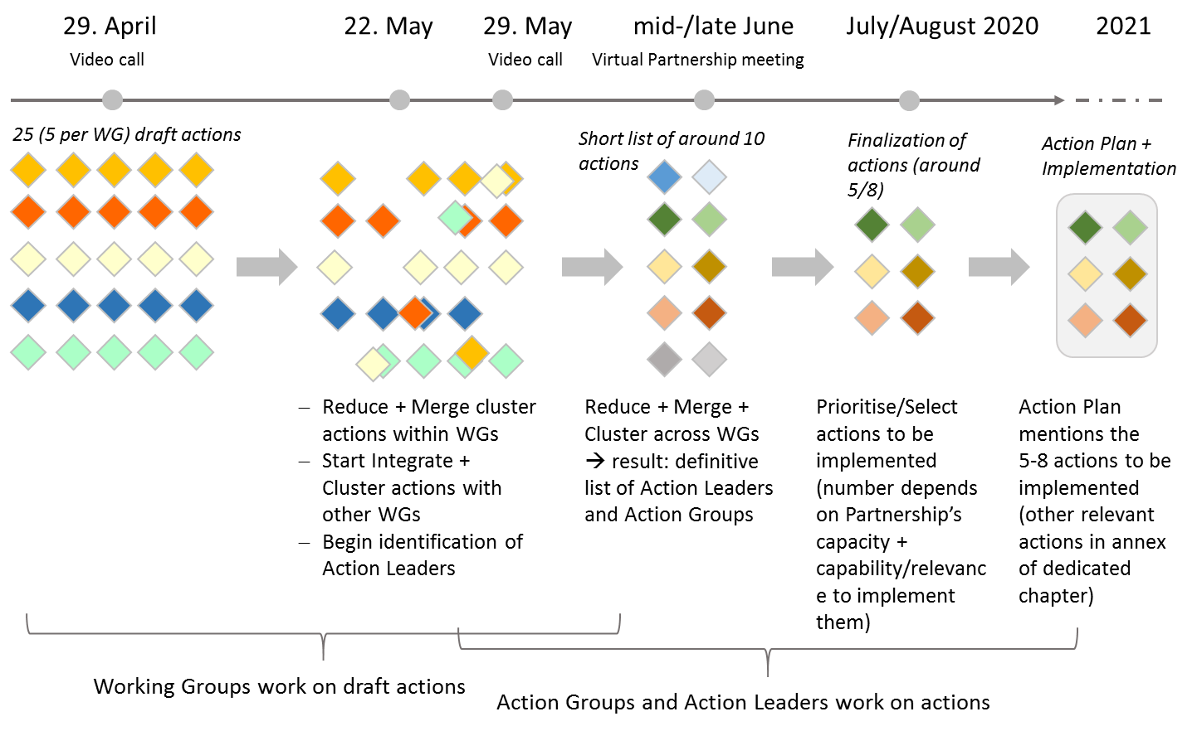
Towards the Action Plan
RESULTS FROM:
Orientation paper
Working Groups
Exteral Expert inputs

Slide 17
Synthetic grid of merged Actions

Slide 18
Obj. of plenary meetings 1 and 2
Presentation of final Draft Actions by potential Action Leader.
Discussion on their relevance;
Preliminary expression of interest by Partners in view of their participation at the Action definition (Action Plan) and implementation (feasibility);
Committment of Action Leaders and members to prepare next steps (finalization of Action Plan)

Slide 19
Discussion of Actions (18/06)
Presentation of final Actions by potential Action Leader
Ranking of actions:
Partners are invited to vote their preference for a number of Actions (up to 5 choices ) that are most important for the Partnership’s Action Plan (relevance)
Partners are invited to vote (up to 3 choices) their interest for being involved and worked in Actions (feasibility)
At the end of meeting the Partnership will be aware of the interest risen around Actions and have a first idea of the possible composition of Actions group.

Slide 20
Criteria for „evaluating“ the Actions
Feasibility
Strategic relevance for all (EU level)
Effectiveness and impact
Financial commitment and resources
Active Leadership!
Let‘s also keep in mind that actions should be:
New and innovative
they should not be in the pipeline or being implemented anyway, anyhow
Integrated with other policy tools/projects

Slide 21
Obj. of Plenary meeting 2 (25/06)
According to the results of the ranking of actions achieved at the 18 June and after a consultation activity among partners:
CONSOLIDATION OF ACTION GROUPS;
methods and tools of the Action design process.
At the end of the 2 meetings, the Action groups will be set and ready to start writing the actions for the Action Plan to be finalised before 3rd of September !!!

Slide 22
Presentation of the short-listed Actions
By Working Group Leaders/Potential Action Leaders

Slide 23
Working Group 1: Cultural Tourism
Manuela Taverniti | City of Florence

Slide 24
Action 1: Data collection and smart use applied to the management of tourist flows
Objective(s):
  To become a Smart Destination by promoting sustainable and “safe” tourism
  Balancing tourist flows - overcrowded destinations/less visited sites
Challenge tackled:
  Lack of data to properly measure the sustainability of tourism
  Critical issues related to management and data sharing system (privacy, IT security, interoperability…)
  (and with respect to Covid) safeguarding and protecting health of visitors and tourist workers
Output(s):
  Definition of a possible model (more qualitative performance indicators)
  Definition of European guidelines for strategic planning of tourist sites based on data analysis
Potential Action Leader: City of Florence
Possible tool of implementation/pilot: Feel Florence as an usefuIT tools l to better manage/balance tourist flows

Slide 25
Action 1.3: Regulating new spread phenomena of the sharing economy
Objective: to provide an autonomous, cohesive and structured regulation framework for sustainable cultural tourism
Challenge tackled:
  impact of the big players in the real estate market – gentrification
  preserving the identity of cultural places from the impact of mass tourism
  addresses the current gaps in the ability of cities to regulate platforms
  revisit and update both its 2016 Agenda on the collaborative economy and the E-commerce directive of 2000
Output(s): Developing recommendations for EU guidelines and regulatory interventions to create an effective regulatory framework in areas such as shared economy accommodations and new tourism service platforms
Potential Action Leader: TBD

Slide 26
Action 1.5: European Task force for crises in tourism sector
Objectives:
  Improve crisis management strategies
  Strengthen coordination mechanisms to find common solutions
Challenge tackled:
  Face crisis especially in situations characterized by rapid evolution
  effective system to monitor the impact of the COVID-19 crisis on tourism
  support sector recovery
Output: Establish a European task force to counter the negative effects caused by the COVID-19 emergency in the tourism sector and prevent other similar shocks in the future
Potential Action Leader: TBD

Slide 27
Thank you for your attention!
If you have any questions, please write your name and organisation in the chat box (send to: all participants).
We will then give you the floor to share your views (depending on the time available).

Slide 28
Working Group 2:
Creative and Cultural Services
Mercedes Hernández & Kasper van Hout | Murcia City Hall

Slide 29
Action 2: Cultural Street Invasion
Objective(s): Singular atomised actions in the public domain, reconquering public spaces, promoting the fragmented cultural consumption.
Challenge tackled: Disengagement in culture consumption, avoiding agglomerations, reducing and avoiding barriers to culture consumption.
Output(s): Analysis Tools, Culture Model, Implementation Tools, Digitalisation Guidelines, Routes, Street Actions, etc.
Potential Action Leader: Murcia

Slide 30
Action 3: CHIME
Cultural Hubs for Innovation, Modernisation and Enhancement
Objective(s): creative hubs that constitute a platform to strengthen artistic production and innovation, supporting local economy and cultural offer, promoting culture to enhance local identities
Challenge tackled: lack of physical spaces to experiment with culture creation and artistic expression, job creation around the cultural and creative industries, vulnerability of self-employed artists, etc.
Output(s): Cultural Testing Tubes to support local economy and cultural offer, creating ideas and new content, composing, designing, writing, performing, etc. – Guidelines for Creation, Culture Model, Management Model, Tools for implementation, monitoring, evaluation, etc.
Potential Action Leader: Murcia

Slide 31
Action 4: Cultural Reactives
Objective(s): Structured and planned cultural procurement through municipal spending focussing on digitalisation, remote cultural offer, new culture opportunities, added value, and improving standards for enhancing quality
Challenge tackled: Palliating detrimental effects on the cultural sector and culture production, reduced culture consumption, disengaged peri-urban areas, tackling the issues related to the “new normality”
Output(s): Procurement model for incentivising culture production, including set-up, evaluation, monitoring and outcomes. Cultural actions/ expressions
Potential Action Leader: Murcia (tutor for implementation)

Slide 32
Action 5: PPC driven cooperative heritage management
Objective(s): Re-use of cultural heritage buildings in Public-Private Cooperation (PPC) and cooperative arrangement management model through the use of CCIs
Challenge tackled: Cultural heritage abandonment, over-exploitation or under-funding, leading to inefficiency, neglect and decay. Need for alternative resources and funding sources and new ways of public-private cooperation models.
Output(s): Guidelines for sustainable public-private cooperation in abandoned cultural heritage, model(s) for supporting cultural and creative companies, model(s) for managing cultural factories and incentivising culture production
Potential Action Leader: TBD

Slide 33
Thank you for your attention!
If you have any questions, please write your name and organisation in the chat box (send to: all participants).
We will then give you the floor to share your views (depending on the time available).

Slide 34
Working Group 3:
Transformation, adaptive reuse and Urban reconversion
Sandra Gizdulich & Giovanni Pineschi
| ACT (IT)

Slide 35
Action 6 (ex 3.1): Collaborative management to readapt / reuse spaces & buildings for cultural and social development
Objective(s):
Re-use of empty spaces or ancient buildings that might constitute an important identity for a given area (i.e. a former factory, military barracks, historical garden, etc.) and of interests for citizen or urban users that would like to adapt them to enhance the life in the neighbourhood offering social/cultural services.
Challenge(s):
Difficulty in recovering spaces by Local Administration due to: financial or human resources, project’s management capacities, properties framework, different local interests … empowering citizen to take care of these goods is a possible solution, but it is still an experimental minor practice (problem of co-design, procurement and state aid).
Output(s):
analysis of existing present practices and local regulations (“reasoned catalogue”);
proposal of a model to foster collaborative management as a systematic methods;
promotion of such places for culture destinations to create balanced distribution of touristic flow.
Potential Action Leader: Italian Agency for the Territorial Cohesion (ACT)

Slide 36
Action 7 (ex 3.2):
Urban Strategic Plan for culture and cultural heritage enhancement
Objective(s):
The Action Plan for the Urban Culture fosters the better management, enhancement and protection of the urban cultural heritage considered as an urban ecosystem.
The action will setup an innovative model of planning tool aimed at:
recognizing all the forms of cultural heritage laying in the cities and in the surrounding territory;
defining a strategic programme for the enhancement of existing heritage by coordinating investments, direct and indirect support of local economies.
combining all urban culture fragments in a coherent and effective strategy of heritage enhancement at local level (recomposing funding of local, national, ESIF funds)
Challenge(s):
Despite all cities declared that culture is important, culture is usually implemented through different and fragmented interventions without an overall holistic vision and a clear strategy for the culture and the cultural heritage enhancement as a real driver for the urban asset and local economy.
Output(s)
Model of Urban strategic Plan for Culture
Practices collection on Culture based planning
Potential Action Leader: Italian Agency for the Territorial Cohesion (ACT)

Slide 37
Action 8 (ex 3.3):
Interactive and demonstrative platform on adaptive heritage for economic values
Objective(s):
The action is aimed at setting up a living and interactive web - based platform as an International Hub.
The proposed action concerns the development of a tool to concentrate all relevant information in a integrated platform focused on urban policies using culture and cultural heritage as a driver for local economies.
Challenge(s):
Currently there are a lot of initiatives ongoing on this topic, on national and European level. A lot of information is currently dispersed on different websites and other sources.The portal should be promoted as a “convergence hub” for urban policies based on cultural resources. In this view, the portal should deepen the financial and economical aspects related to the practices collected, in order to foster their transferability through the European cites, by assessing procedures, bottlenecks, enabling conditions, cost and returns on investments: a sort of advanced assessment of practices.
Output(s):
Web based platform model
Network of participants
Board for management of the Platform
Potential Action Leader: to be defined

Slide 38
Thank you for your attention!
If you have any questions, please write your name and organisation in the chat box (send to: all participants).
We will then give you the floor to share your views (depending on the time available).

Slide 39
Working Group 4:
Resilience of Cultural and Natural Heritage
Jan Schultheiß | Germany (BMI)
Giuliana De Francesco | Italy (MiBACT)
Lena Hatzelhoffer, Torsten Deppe | Germany (BBSR)

Slide 40
Action 9: UNESCO Manual on DRM (4.2)
Objective:
  Fostering the adoption of integrated approaches in risk and heritage management and strengthening disaster preparedness of culture and cultural heritage in our cities by transferring an existing UNESCO manual on managing disaster and risk at UNESCO World Heritage Sites to the European level/ European cities
Challenge tackled:
  Lack of integrated approaches in the field of risk and heritage management at the local/ regional level
  Lack of a common understanding and exchange of views in the field of heritage management, urban development, risk and catastrophe management as well as academia in Europe
  Low priority of cultural heritage in risk management planning
Outputs and Activities:
  The Action will bring various professionals from relevant sectors together in a workshop in order to discuss how to transfer the existing UNESCO manual to the European level/ European cities
  The Experts will analyze which principles for an integrated approach in risk-heritage management in European cities can be derived and developed on the basis of the UNESCO Manual
  The guiding principles for an integrated approach in risk-heritage management as well as recommendations about how to adjust the general principles to specific local situations will be compiled in a short publication
Potential Action Leader:
  Germany

Slide 41
Action 10: Observatory/Laboratory
Objective:
The impact of climate change on cultural heritage is of a global awareness. Nevertheless concrete common measures were not even conceived yet. C/CH can also contribute to climate action and related social awareness and participation. The Green Deal fosters an ecological reconversion of urban areas, but there are no common understandings yet and there is the need to prevent loss of CH values in the process.
Challenge tackled:
Implementation of integrated climate adaption plans in the local planning context is a fragmented experience. Field research and analyses of national/European regulations on Cultural Heritage, Climate Change and Adaption Strategies, are needed in order to create a model for the climate action to benefit the local planning context with recommendations on the use of EU funding and the implementation of climate adaption plans.
Outputs and Activities:
Building upon previous experience (Climate Adaptation and Sustainable Land Use partnerships) and upon the multilevel, multistakeholder governance of the UAEU, the objective of this action is establishing an active observatory, a multilevel laboratory, to share visions and practices, needs and opportunities and start experimental actions on climate change, culture and cultural heritage.
Potential Action Leader: IT (MiBACT with cities)

Slide 42
Action 11: Dissonant Heritage in regional tourism (4.H2)
Objective:
  This Action focuses on the often controversial historical heritage of the 20th century and how to strengthen the “Dissonant Heritage” by integrating it in regional tourism concepts
Challenge tackled:
  The touristic development of places and objects of the “Dissonant Heritage" makes a fundamental contribution to cultural education and to the communication of history, which both nurture democracy building in Europe
  BUT the dissonant heritage is often neglected, threatened with demolition or not accessible via tourism infrastructure
Outputs and Activities:
  The Action aims to strengthen democracy building by tackling dissonant heritage as well as to mobilize the economic potential for tourist development and the marketing of unusual memorials and sights
  The Action can include small and medium-sized towns as well as peripheral regions in the EU and their controversial heritage in the study and show their development potential
Potential Action Leader:
  Germany

Slide 43
Thank you for your attention!
If you have any questions, please write your name and organisation in the chat box (send to: all participants).
We will then give you the floor to share your views (depending on the time available).

Slide 44
Working Group 5:
Cultural Services and Culture for Inclusive Cities
Julie Hervé | Eurocities
Reiner Schmock-Bathe, Daniel Deppe | City of Berlin, Senate Department for Culture and Europe
Christian Perazzone | Canary Islands

Slide 45
Action 12: Identification of cities’ research needs on cultural services and culture for social inclusion (5.1)
Objective(s): identifying cities’ specific research needs. This would be helpful to better plan future EU calls for proposals on research, and to guarantee that results of these research projects are used at local level to improve local cultural policies. Such research projects would usefully be conducted by universities in cooperation with cities and local stakeholders.
Challenge tackled: Better Knowledge
Output(s): a list of specific research topics that cultural leaders from city administrations would find useful to increase their knowledge on. They would use this knowledge to develop their local cultural policies and programmes. This list will be very useful when the EC will prepare future calls for proposals for research programmes, as it will guarantee that the researches that will be financed at EU level will inform local policy making.
Potential Action Leader: EUROCITIES, supported by Espoo and Berlin

Slide 46
Action 13: Peer learning activities for city representatives to learn from each other’s on cultural services fostering social inclusion (5.2)
Objective(s):
Develop a methodology that all cities can use in order to learn from other cities. We propose a focus on culture & social inclusion, but the outcome of this proposed action can be used on all topics. The aim is to share knowledge among cities.
Topics that could be covered (to be decided with members of the partnership): Developing long term local strategies for culture. Developing long term local strategies for culture; Improving participation to cultural activities; Developing new partnerships at local level within the culture sector and with other sectors; Developing new forms of public support to local cultural actors, including non-financial support (production of new support services)
Challenge tackled: Better Knowledge
Output(s): The outcome will be twofold: 1) a methodology for peer-learning activities and visits between cities. In particular, we will take into account the need to develop online methodologies that do not require onsite visits (lesson from the lockdown period). 2) we will arrange a peer learning visit (online or onsite) on one topic (to be agreed with partnership members, ideally linked to culture & social inclusion) to test the methodology developed in 1)
Potential Action Leader: EUROCITIES & URBACT, supported by Espoo and Berlin

Slide 47
Action 14: Raise awareness for public libraries on a European and National Level
Objective:
  Raise awareness for public libraries and their new tasks on a European and National Level
Challenge tackled:
  weak recognition of public libraries and their importance for digital and social participation and community empowerment in the digital information and knowledge society
  challenges on the way of public libraries to become a "great good place" (words of Ray Oldenburg)
  weak recognition of public library online services
Outputs and Activities:
  document analysis → overview of missed opportunities about library potentials concerning urban development and social cohesion
  survey and analysis of financial funding for change processes in public libraries → knowledge about financial sources and opportunities for libraries to modernize and innovate
  web/community page on modern libraries as “third places” → Collection of visible best practice examples to use for lobbying and inspiration on national and EU-level
Potential Action Leader:
  City of Berlin, Senate Department for Culture and Europe

Slide 48
Action 15: Citizen Engagement on Risk and Cultural Heritage (4.H1)
Objective:
  Identification of the real needs in cultural services and cultural heritage of the citizen based on a specific and participatory work with population in situations of social, cultural, educational and health exclusion.
Challenge tackled: Better knowledge for better funding
Outputs and Activities:
  The outcome will be a list of specific topics, elaborated by the interested owners of marginal barrels in exclusion that will receive these cultural actions of inclusion, that cultural leaders from city administrations would find useful to develop their local cultural policies and programmes. This list will be very useful when the EC prepares future calls for proposals for action programs, since it will respond to the demand issued directly by the stakeholders that will be financed at the EU level will inform the formulation of local policies.
Potential Action Leader: Canary Islands Government

Slide 49
Thank you for your attention!
If you have any questions, please write your name and organisation in the chat box (send to: all participants).
We will then give you the floor to share your views (depending on the time available).

Slide 50

COFFEE BREAK!
(5 minutes)

Slide 51
Ranking of Actions

Slide 52
Please go to www.menti.com and use the code 48 85 84
Please note that, for reference, the numbers and names of the Actions are listed also in chat box

Slide 53
Discussion
If you have any questions/comment, please write your name and organisation in the chat box (send to: all participants).
We will then give you the floor to share your views (depending on the time available).

Slide 54
Conclusions and next steps

Slide 55
Agenda for 25 June
Please think about your committment to become an Action Leader!
Please use your communication channels to give visibility to the Public Consultation!
Please mark your calendars!:
  EWRC Brussels (or virtual) 12-15 October
  Stakeholder Conference Berlin (or virtual)
  24/25 November

Slide 56

Thank you!
See you on Thursday 25 June

